Slide 1


4 Online Workshops on the INSPIRE-Soil GeoPackage 2st Workshop
The INSPIRE-SOIL GeoPackage has been produced by
Andrea Lachi, Giovanni L’ Abate, Maria Fantappiè [CREA, Council for Agricultural Research and Economics of Italy] with the support of Stefania Morrone [Epsilon Italia srl].

Slide 2
Outline
11:05 -11:15
11:15 – 12:05
12:10 – 13:00
First workshop wrap-up
The INSPIRE SO GPKG
INSPIRE SO GPKG in QGIS
Mentimeter results
Lesson learnt
11:15 – 11:45
What you find inside the GitHUB
Demonstration of the INSPIRE SOIL Geopackage through a DBMS (Database Management System)
11:45 – 12:05 Q&A
12:05 – 12:10 Coffee break
12:10 – 12:40
QGIS – STYLES Custom Forms for QGIS (data entry/view)
Demonstration of the INSPIRE SOIL Geopackage use with QGIS
HALE studio transformation (if there is time …)
12:40 – 13:00 Q&A & Mentimeter

Slide 3
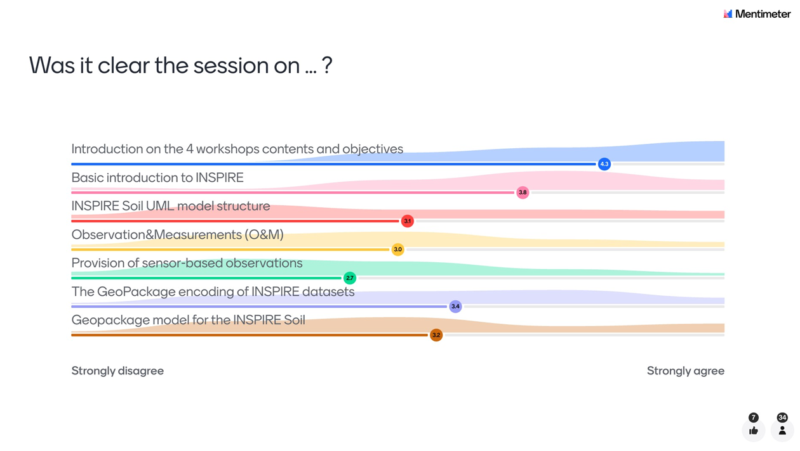

SOME RESULTS FROM THE MENTIMETER AT FIRST WORKSHOP

Slide 4
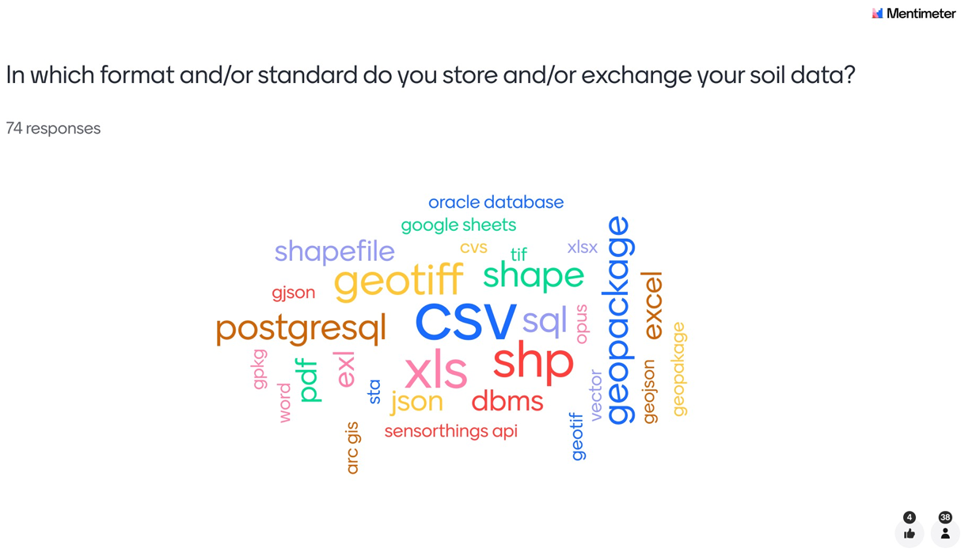
SOME RESULTS FROM THE MENTIMETER AT FIRST WORKSHOP

Slide 5
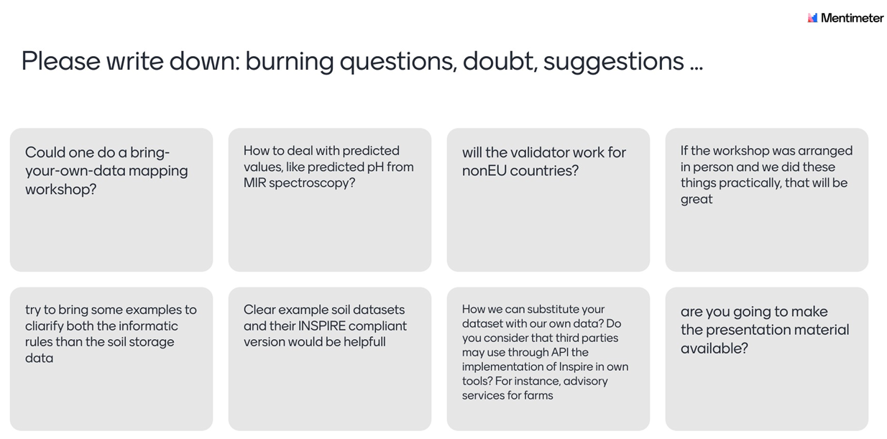
SOME RESULTS FROM THE MENTIMETER AT FIRST WORKSHOP
Examples of input from other datasets at 3° and 4° workshop
It is «just» about
adding MIR process => 4th workshop
YES
Yes, it would be great! Maybe under Soilwise?
Examples of input from other datasets at 3° and 4° workshop
Examples of input from other datasets at 3° and 4° workshop
Reply now
DONE

Slide 6
SUMMARY LESSONS LEARNT AT THE FIRST WORKSHOP
INSPIRE is an EU Directive (Directive 2007/2/EC), aimed at creating an INfrastructure for SPatial Information in EuRopE facilitating the sharing and re-use of data across the EU in support of environmental policy and decision-making.
INSPIRE sets the Implementing Rules (IR) and Technical Guidelines (TG) for the implementation, and a specific technical guideline for Soil Theme exists.
Some simplification of INSPIRE has been allowed to facilitate the implementation, together with a new governance
The INSPIRE Good Practice mechanism is part of this new INSPIRE governance.
Following the INSPIRE implementing rules (IR) the format for data sharing should be GML, but the use GeoPackage encoding has been allowed as a Good Practice.
Developed by OGC as an open format for geospatial information, the “GeoPackage is an open, platform-independent, portable, self-describing, compact format for transferring geospatial information”. A single file can store and handle large numbers of spatial features and related attributes in a relatively small size. It can also store tile matrix sets of imagery, raster maps, tile gridded coverage data, metadata and schema constraints. It is particularly suitable for use in a GIS (desktop) environment.
EJP SOIL has developed a INSPIRE SOIL GEOPACKAGE template, following the approved vector and O&M INSPIRE UML models for Soil, combined with the Sensor Observation Service (SOS) standard.
The EJPSOIL INSPIRE SOIL GEOPACKAGE has been transformed to GML structure and successfully validated inside the INSPIRE validator.
Given the successful validation, the INSPIRE SOIL GEOPACKAGE developed by EJPSOIL can be used by EU Member State for INSPIRE compliant soil data sharing.

Slide 7
The INSPIRE SO GPKG
A Good Practice to facilitate the encoding of soil data in accordance with the INSPIRE Soil Data Specifications
Introduction to the INSPIRE-SOIL Geopackage. Examples of practical usage for single data upload and data consultation, through QGIS.

Slide 8

INSPIRE SOIL GitHUB contents
https://github.com/ejpsoil/inspire_soil_gpkg_template
Notes:
v.1.1-RC - Release Candidate
GitHub
https://github.com/ejpsoil/inspire_soil_gpkg_template/tree/main
Download GPKG > Version1.1-RC/geopackage/INSPIRE_SO_with_data_and_QGIS_project/INSPIRE_SO.gpkg

Slide 9
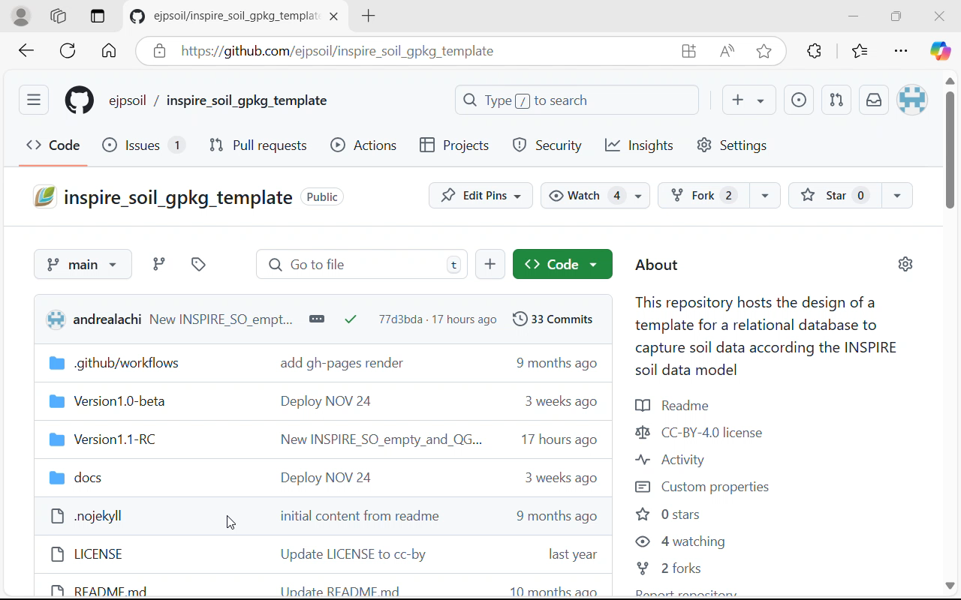
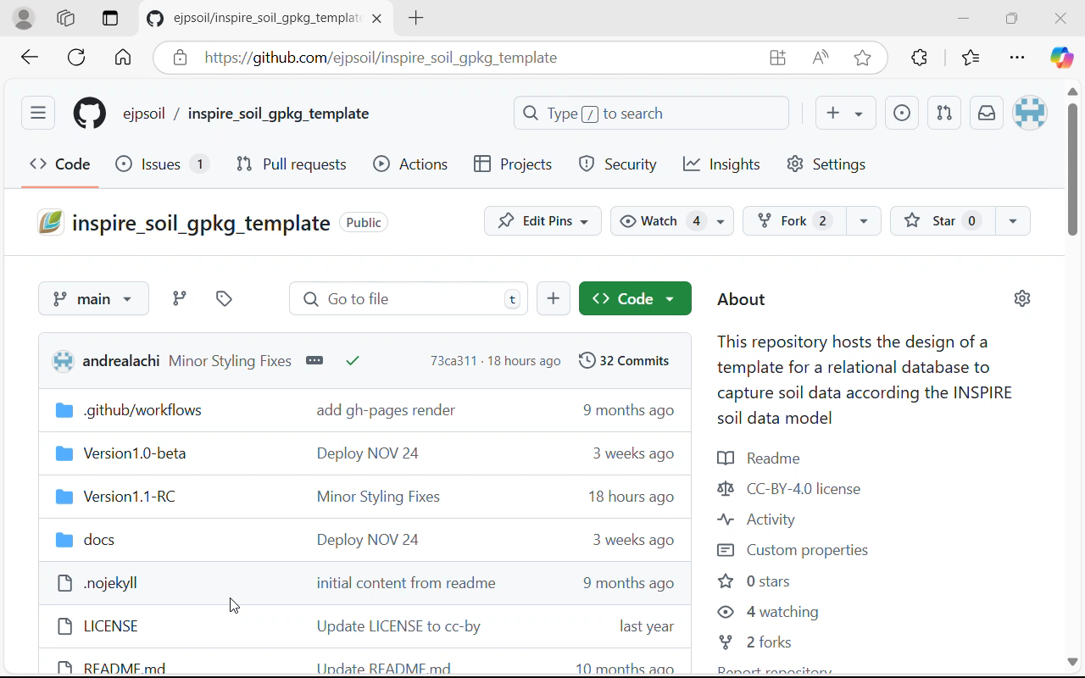




GitHub Repository
INSPIRE SO TEMPLATE GPKG
Docs
INSPIRE SO TEMPLATE GPKG + STYLES + QGIS PROJECT
Sql
Geopackage
INSPIRE SO TEMPLATE GPKG + SICILY SAMPLE DATA
Qgis Style
INSPIRE SO TEMPLATE GPKG + SICILY SAMPLE DATA + STYLES + QGIS PROJECT
Halestudio
Notes:
Last version: 1.1 Release Candidate;
DOCS: Encoding rules of the D6.4 Software framework for a shared agricultural soil information system; INSPIRE SO Geopackage User Manual for compiling single features by means of Qgis; Tested GML files

Slide 10
GitHub Repository (provides)
Docs
Sql
Geopackage
DB INSPIRE SO Template
Qgis Style
Custom Forms for Qgis (data entry/view)
Halestudio
ETL Project for INSPIRE SO GPKG->GML
conversion

Slide 11


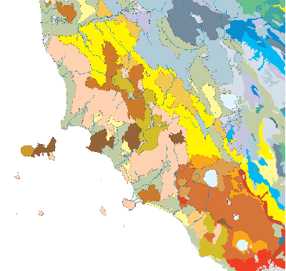
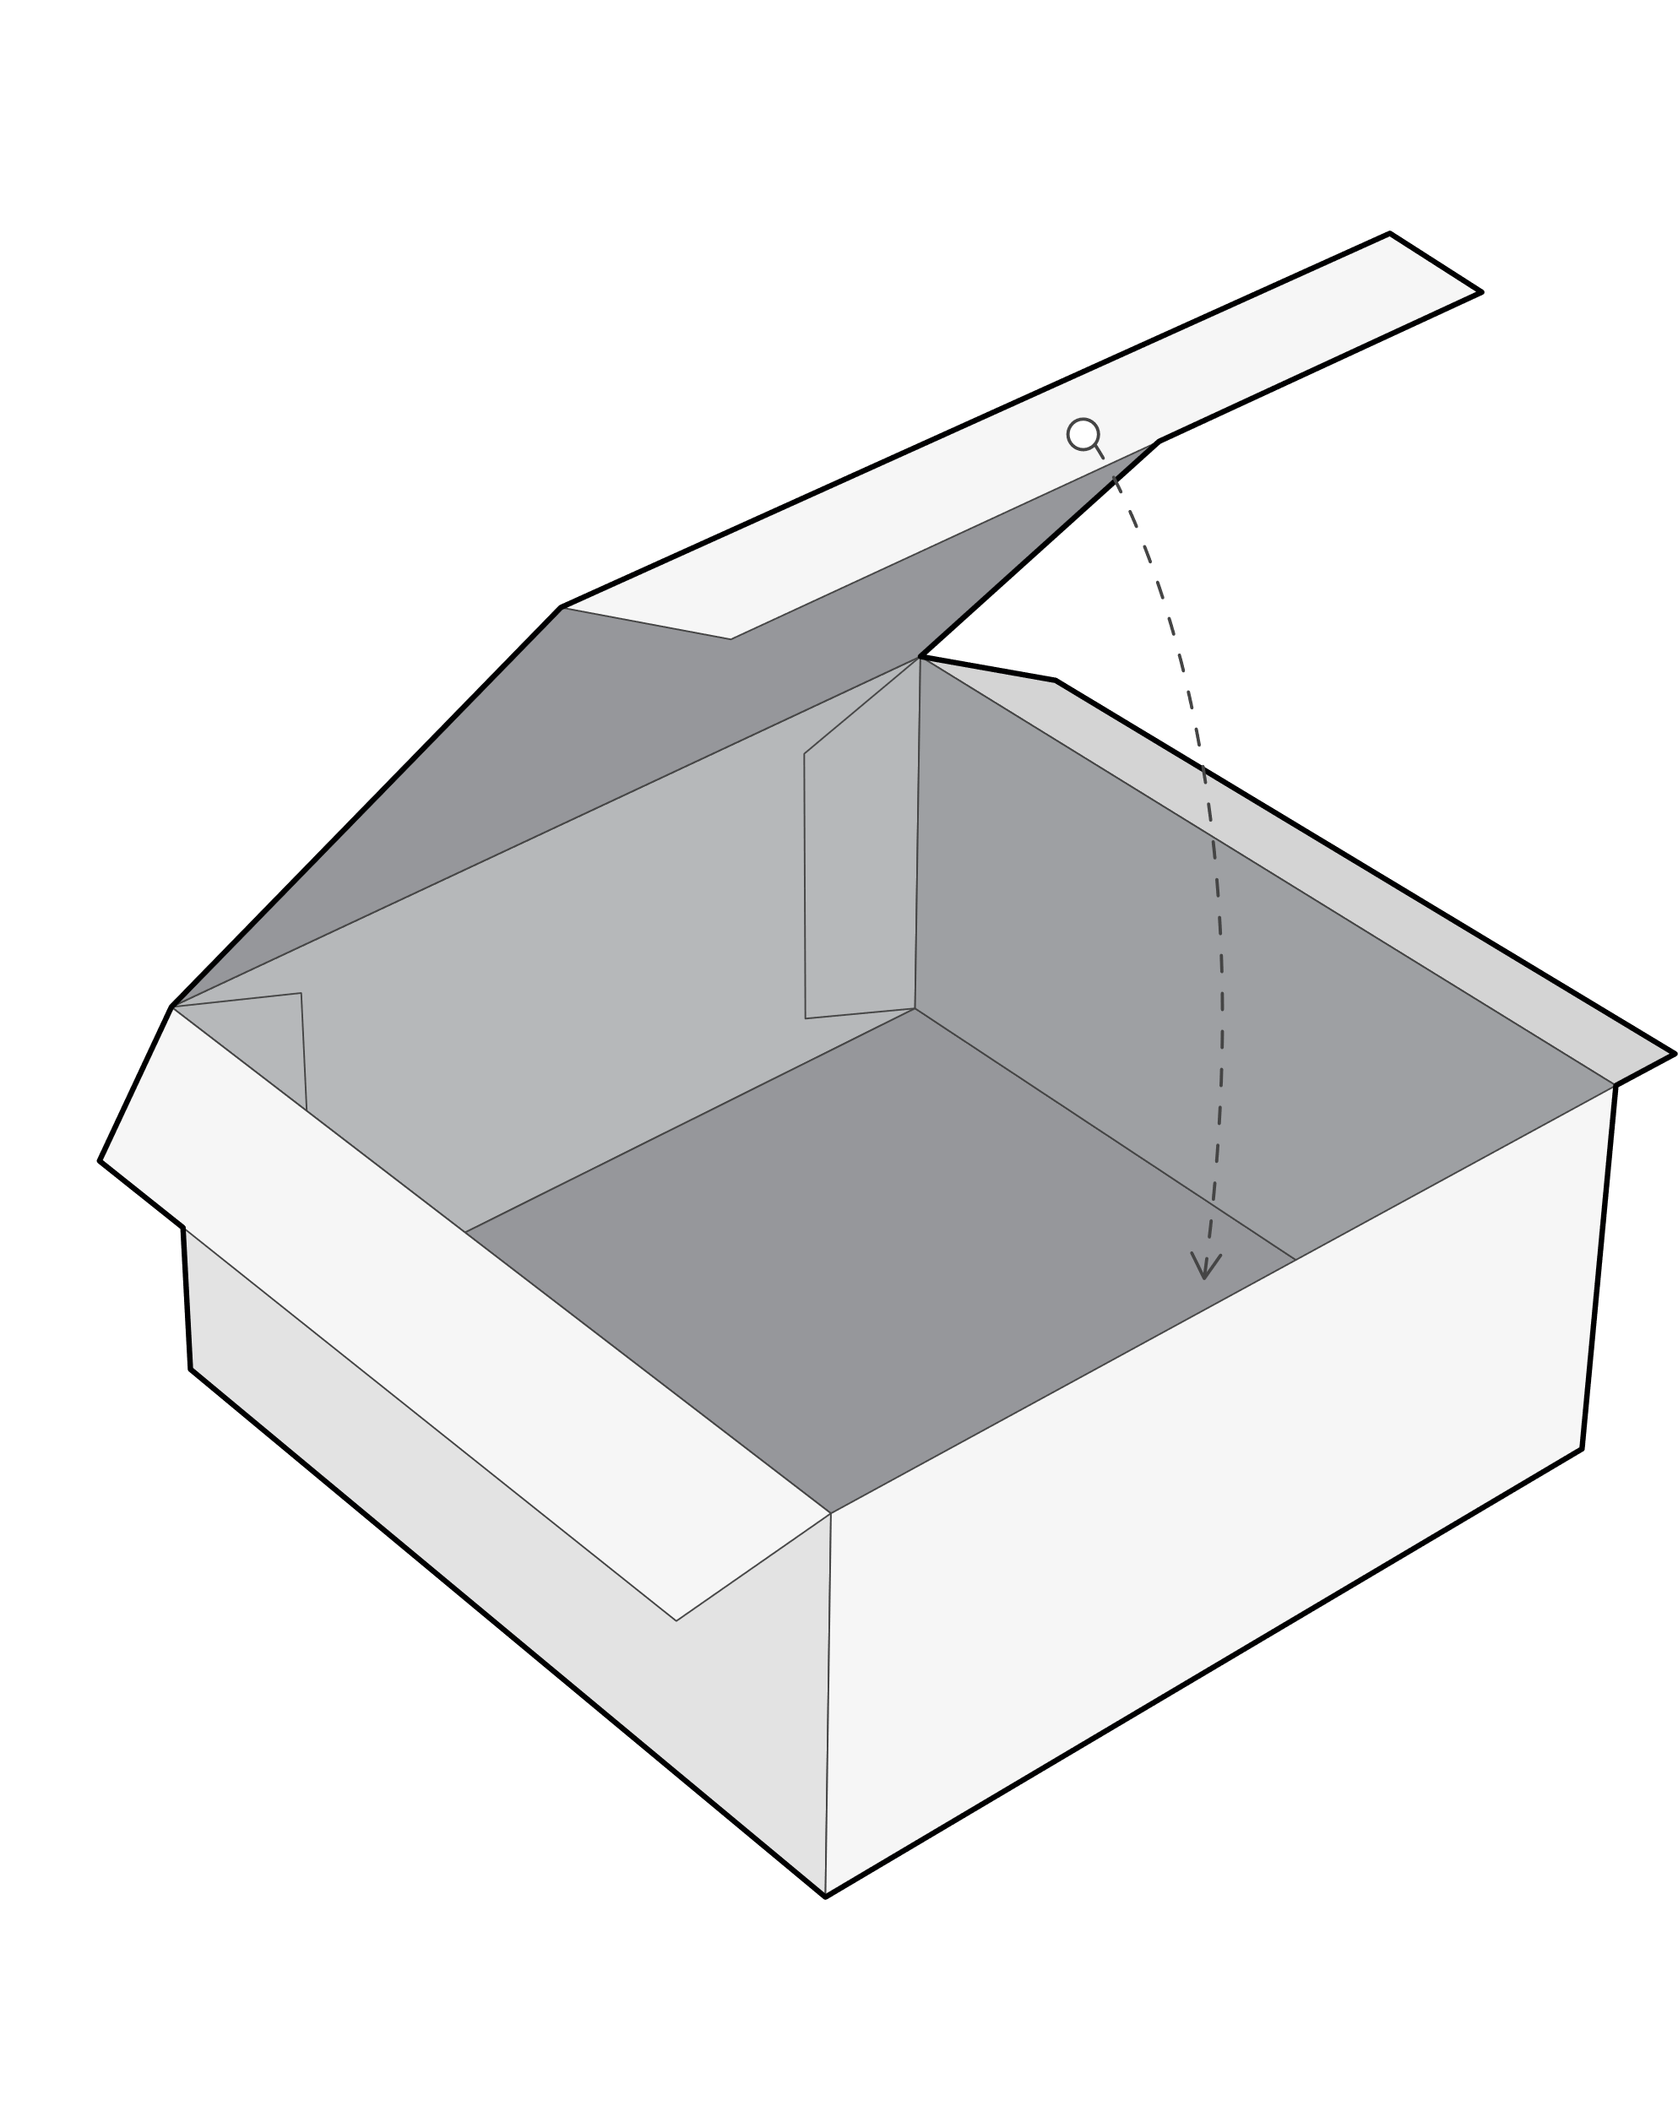
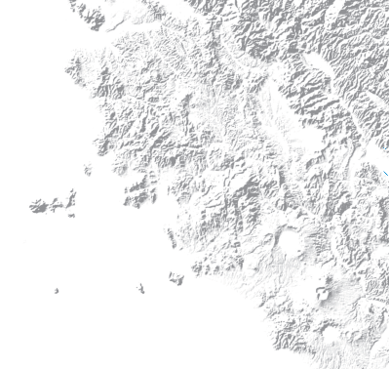
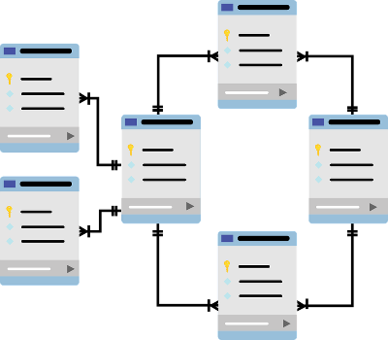
WHAT IS A GEOPACKAGE?
VECTOR
RASTER
RELATED TABLES

Slide 12
DEMO Geopackage / DBMS Live demonstration of the INSPIRE SO GPKG Template through a DBMS (Database Management System)

Slide 13
Online demonstration …
Notes:
Passi per caricamento progetto in Qgis
Navigatore Database (oggetti); Diagramma ER
Tabelle > SoilProfile: Dati e Diagramma; Colonne; Chiavi; Indici; Referenze; Trigger
SQL Example:
WITH MaxDepthPerProfile AS ( SELECT pe.ispartof AS soilprofile_guidkey, sp.wrbreferencesoilgroup, MAX(pe.profileelementdepthrange_lowervalue) AS max_depth FROM profileelement pe INNER JOIN faohorizonnotationtype fn ON pe.guidkey = fn.idprofileelement INNER JOIN soilprofile sp ON pe.ispartof = sp.guidkey WHERE fn.faohorizonmaster_1 != "http://inspire.ec.europa.eu/codelist/FAOHorizonMasterValue/R" GROUP BY pe.ispartof, sp.wrbreferencesoilgroup ) SELECT wrbreferencesoilgroup, ROUND(AVG(max_depth), 2)AS average_max_depth FROM MaxDepthPerProfile GROUP BY wrbreferencesoilgroup;

Slide 14
Q&A TIME

Slide 15


Coffeeee…
….tea

Slide 16
QGIS – Styles – for the Soil Geopackage Custom Forms for QGIS SOIL Geopackage data entry & view

Slide 17

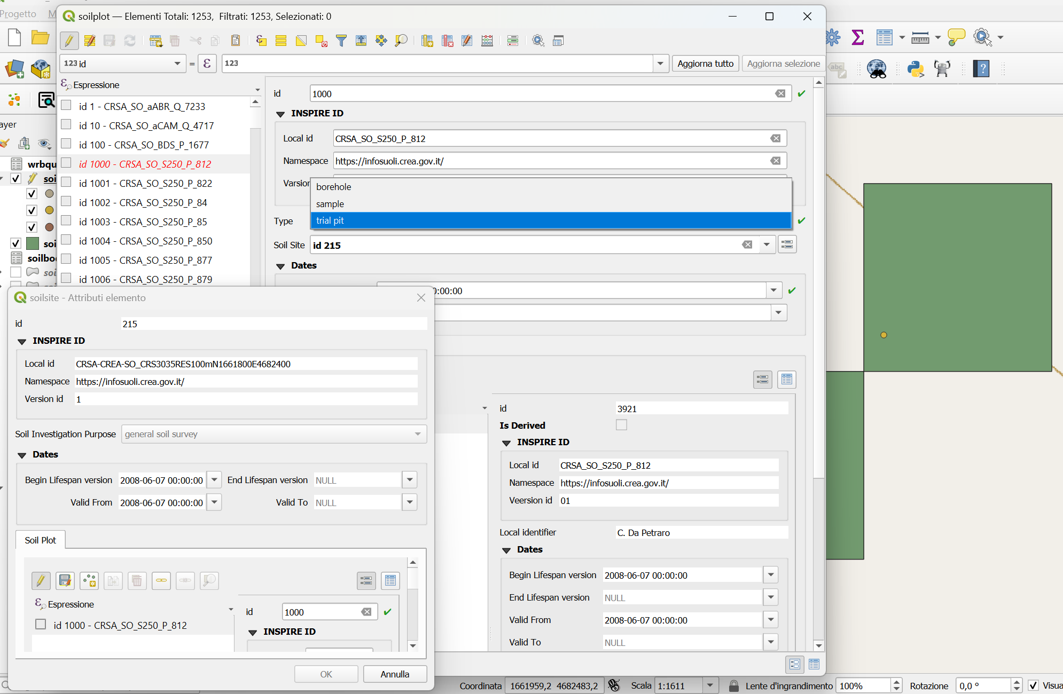
STYLES

Slide 18
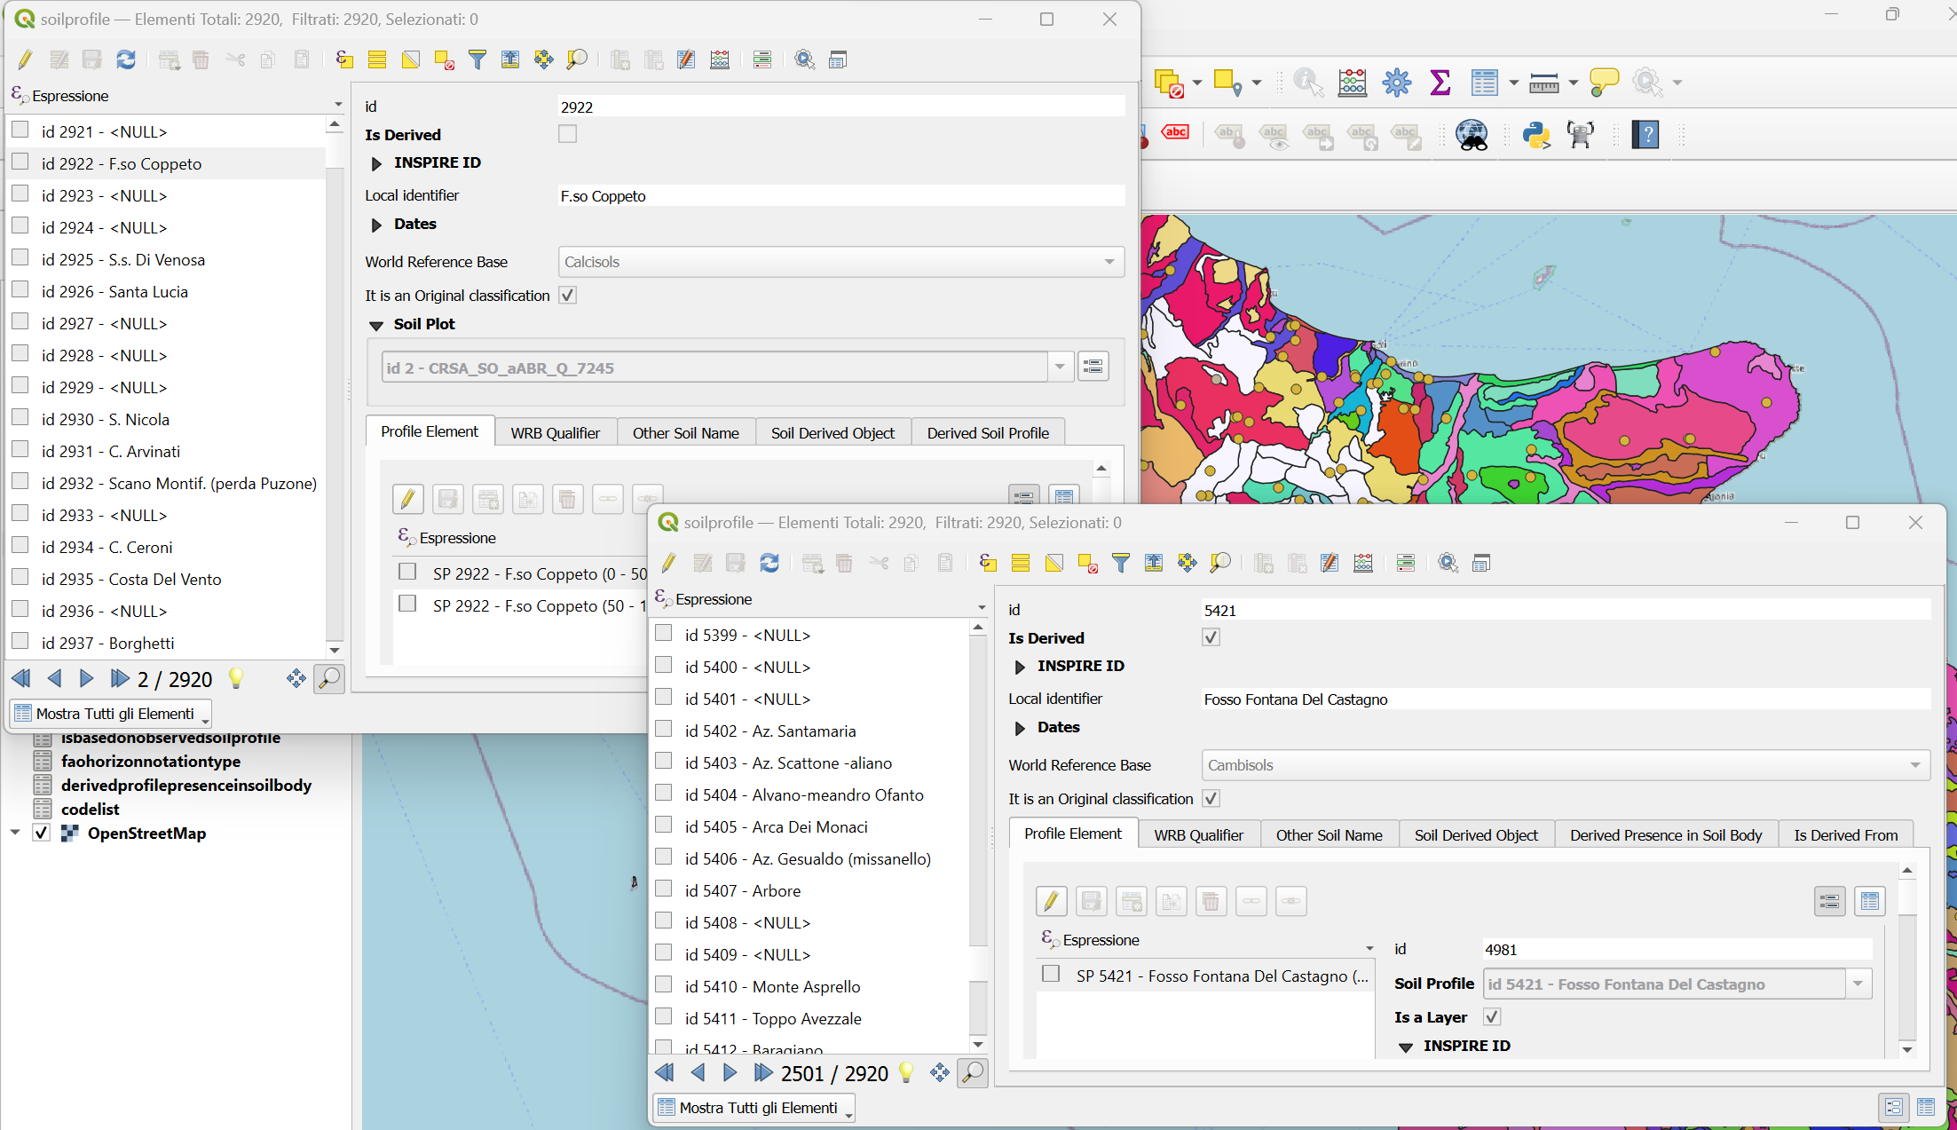
STYLES
Observed
Derived

Slide 19
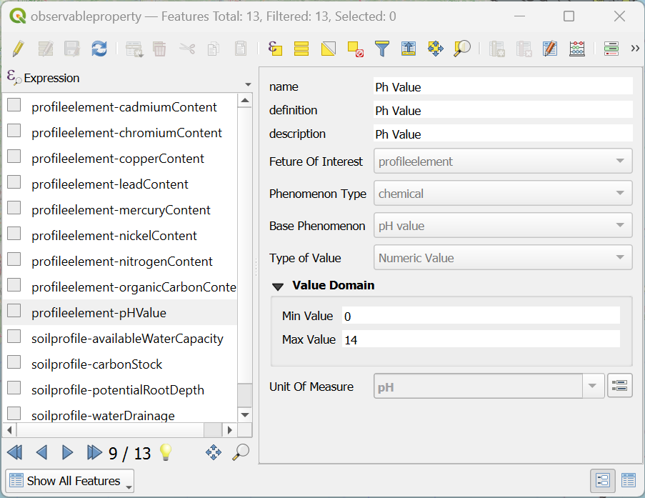
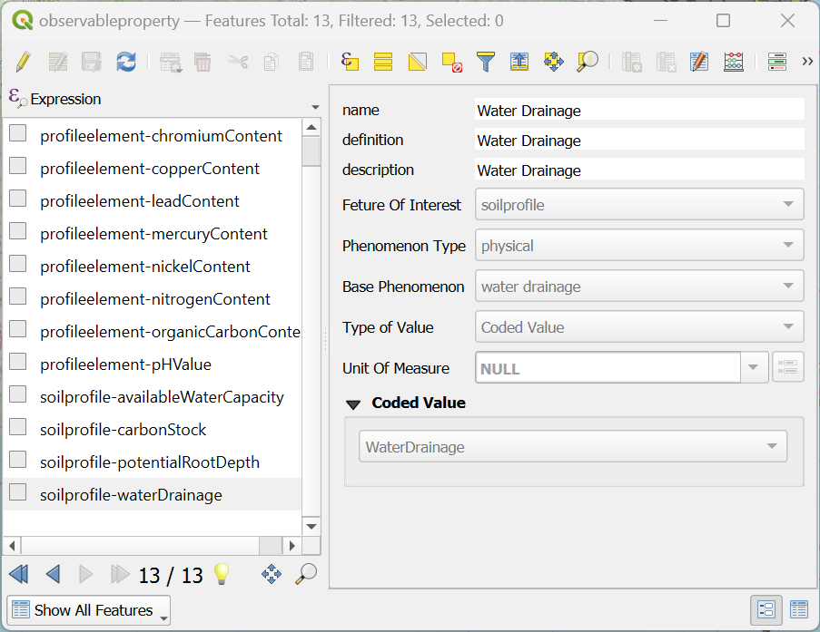
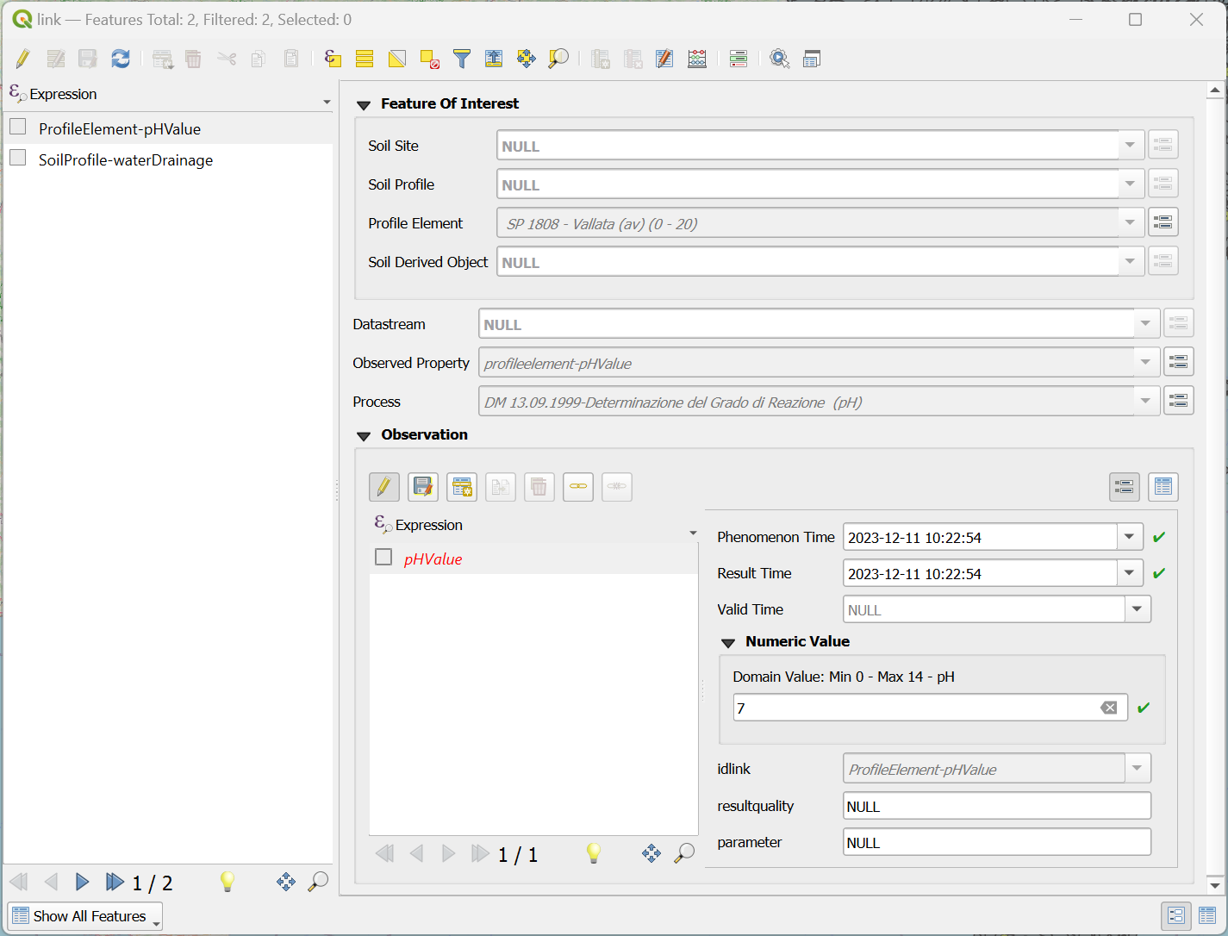
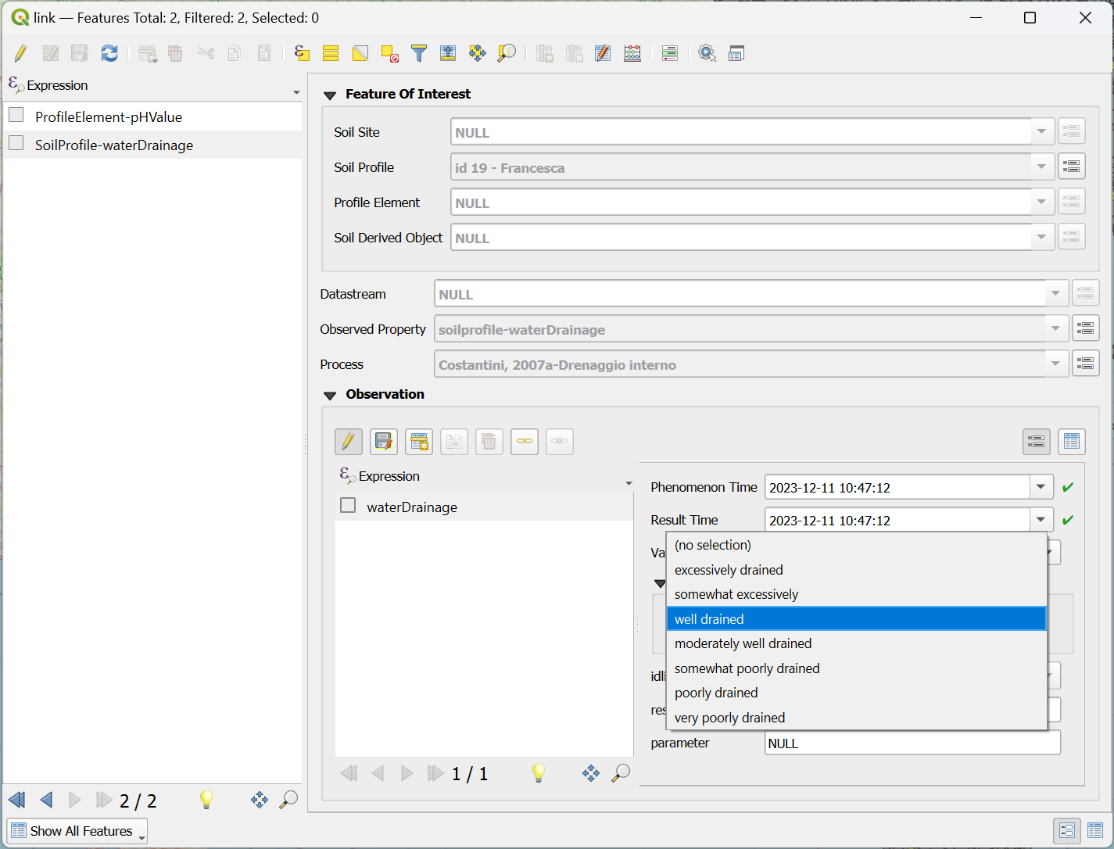
STYLES
Numeric
Coded

Slide 20
DEMO Geopackage / QGIS Live demonstration of the INSPIRE SOIL Geopackage use with QGIS Styles and Processing

Slide 21
Online demonstration …
Notes:
QGIS: Eliminate connection
Layer > Browser
Geopackage > New connection >
SoilPlot (2136)> SoilSite >SoilProfile (Descending) > CRSA_SO_Sps2P6_P (C.DA GORGHI)
SoilProfile (2409)

Slide 22
Demo Hale Studio / Export GML

Slide 23
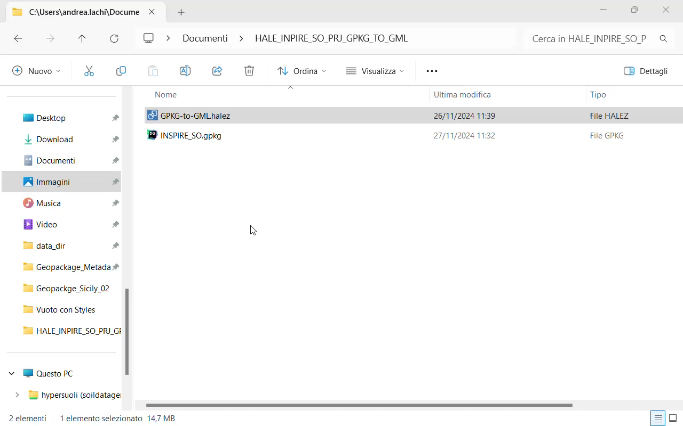
How to use the HALE Studio Project
Open The “GPKG-to-GML” Hale Studio Project
Import the Geopackage Data
Export the GML

Slide 24


MENTI & Q&A TIME
https://www.menti.com/aloxxech2a1u
Thanks for your attention!
We hope to see you on the Third Workshop
9th December 2024, 11.00 to 13.00 am, CET time zone.
Recordings will be available on EJPSOIL YouTube channel https://www.youtube.com/@ejpsoil6391
The presentation will be shared on the EJP SOIL website https://ejpsoil.eu/soil-research/soil-data-monitoring-mapping-and-modelling
For questions: andrea.lachi@crea.gov.it, s.morrone@epsilon-italia.it maria.fantappie@crea.gov.it, giovanni.labate@crea.gov.it

Slide 25





Work in progress
create.sql
create_PostGis.sql
</>
</>
STYLES
Portable
Server

Slide 26
Connect to Geopackage R script library(RSQLite) library(gpkg) My_Geop <- gpkg_list_tables("C:/Users/… /Geopackage/INSPIRE_SO.gpkg") Python script import sqlite3 conn = sqlite3.connect("C:/Users/… /Geopackage/INSPIRE_SO.gpkg") conn.close()

Slide 27


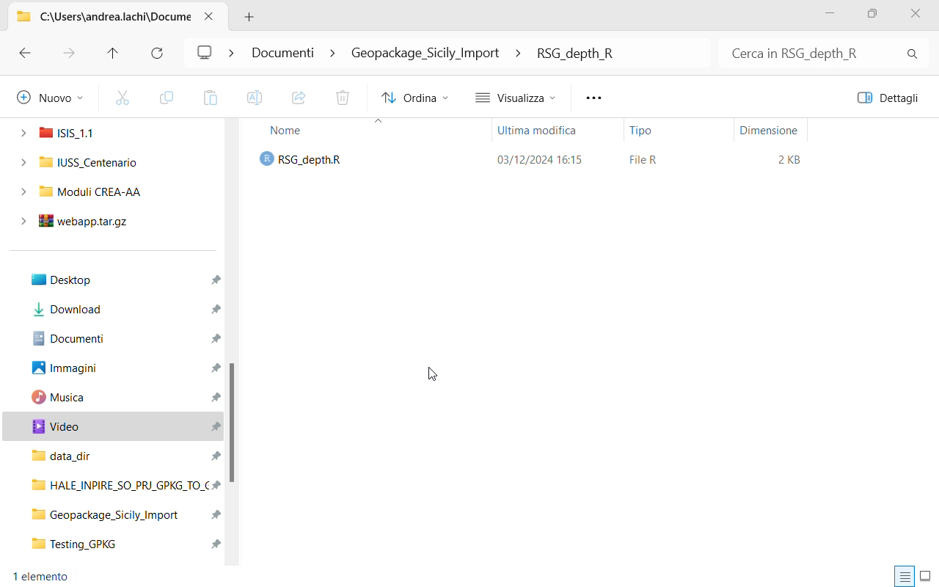
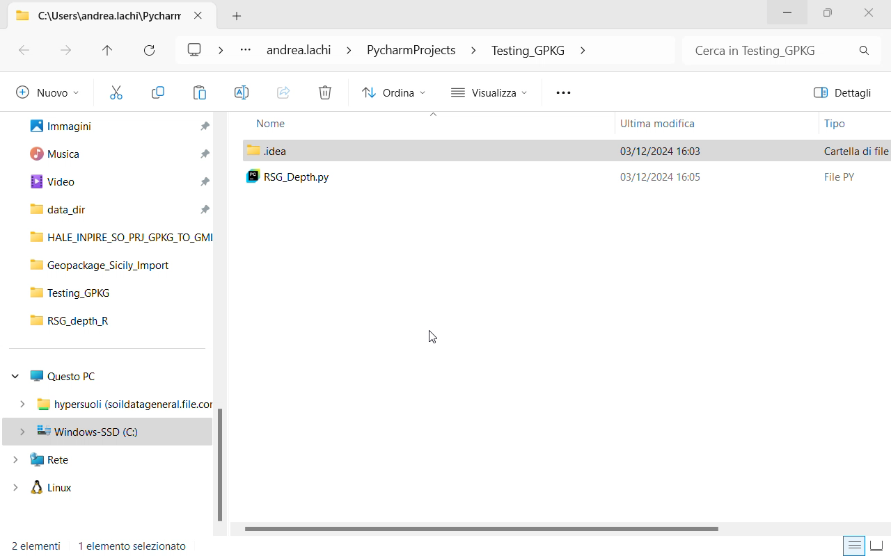
Connect to Geopackage
Python script
R script
library(RSQLite)
library(gpkg)
My_Geop <-gpkg_list_tables("C:/.../INSPIRE_SO.gpkg")
import sqlite3
gpkg_path = "C.../INSPIRE_SO.gpkg"

Slide 28
Particle Size Fraction
D2.8.III.3 INSPIRE Data Specification on Soil – Technical Guidelines
Definition:
Mineral part of the soil, fractioned on the basis of size (diameter), limits of the particles. It indicates how much of the mineral soil material is composed of soil particles of the specified size range.

Slide 29
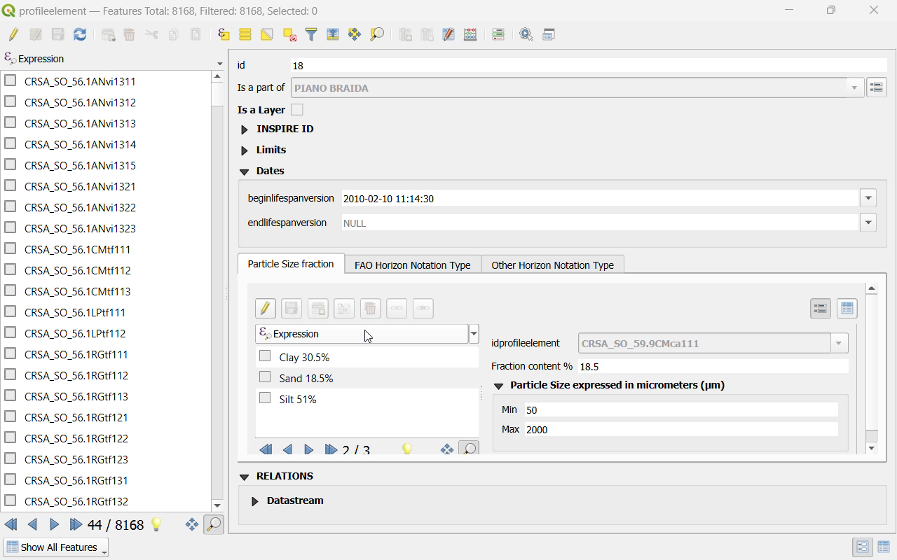
Particle Size Fraction Style
Styles:
Styles are custom-designed forms that assist users in consulting and entering data in a more human-readable format.
Style Changes
The data remains unchanged

